Slide 1
Underlying Knowledge Based Semi-Supervised Learning for Medical Image Classification
Date of Published : August 15, 2023
Jyothi Kiran Boddeda
700769023
Paper Link : https://ieeexplore.ieee.org/document/10218990
Github Link : https://github.com/jyothikiranboddeda/Neural-Network-Deep-Learning/tree/main/Mini%20Project

Slide 2
Motivation
Medical image classification often requires large labeled datasets, but labeling is time-consuming and requires expert knowledge.
Existing semi-supervised learning (SSL) approaches often neglect the rich domain knowledge inherent in the medical field.
Semi-supervised learning can bridge the gap by learning from both labeled and unlabeled data, reducing dependence on annotations.
The UKSSL approach integrates medical knowledge with SSL to improve performance with limited labeled data.

Slide 3
Problem Statement
Medical image datasets often have very limited labeled data due to the high cost and expertise required for annotation.
Most semi-supervised learning approaches fail to incorporate medical domain knowledge such as class semantics or textual descriptions.
Models struggle to effectively utilize unlabeled data without an understanding of class-level relationships.
Existing methods lack interpretability, making their decisions less trustworthy in clinical applications.

Slide 4
Objectives
Develop a semi-supervised learning framework that effectively leverages both labeled and unlabeled medical images.
Integrate medical domain knowledge, such as textual class descriptions, to guide and enhance the learning process.
Design a class-aware consistency regularization strategy to improve prediction stability and semantic alignment.
Achieve higher classification accuracy and better interpretability, especially in low-label scenarios.

Slide 5
Methodology/Main Idea
The UKSSL framework consists of two key components: MedCLR for self-supervised pre-training and UKMLP for semi-supervised fine-tuning.
UKSSL is trained and evaluated on two datasets: LC25000 (5 classes, 25,000 cancer images) and BCCD (4 blood cell types, 12,500 images).
Each dataset is split into 80% training and 20% testing to prevent data leakage, with the test set completely unseen during training.

Slide 6
Methodology/ Main Idea
MedCLR, inspired by SimCLR, uses contrastive learning to extract underlying visual knowledge from unlabeled medical images.
UKMLP leverages this learned knowledge and applies class-aware consistency regularization, fine-tuning the model using limited labeled data.
The complete UKSSL pipeline improves classification performance by combining self-supervised representation learning with medical knowledge.

Slide 7
Results
UKSSL outperforms state-of-the-art SSL methods across LC25000, BCCD datasets.
With just 50% labeled data, UKSSL achieves 98.9% accuracy on LC25000—higher than any method using 100%.
On the BCCD dataset, UKSSL achieves 94.1% accuracy with 50% labeled data, outperforming the best model with 100% labeled data (92.89%).
Accuracy improvements on both LC25000 and BCCD validate UKSSL's robustness and adaptability.
Visual explanations show stronger feature localization.

Slide 8
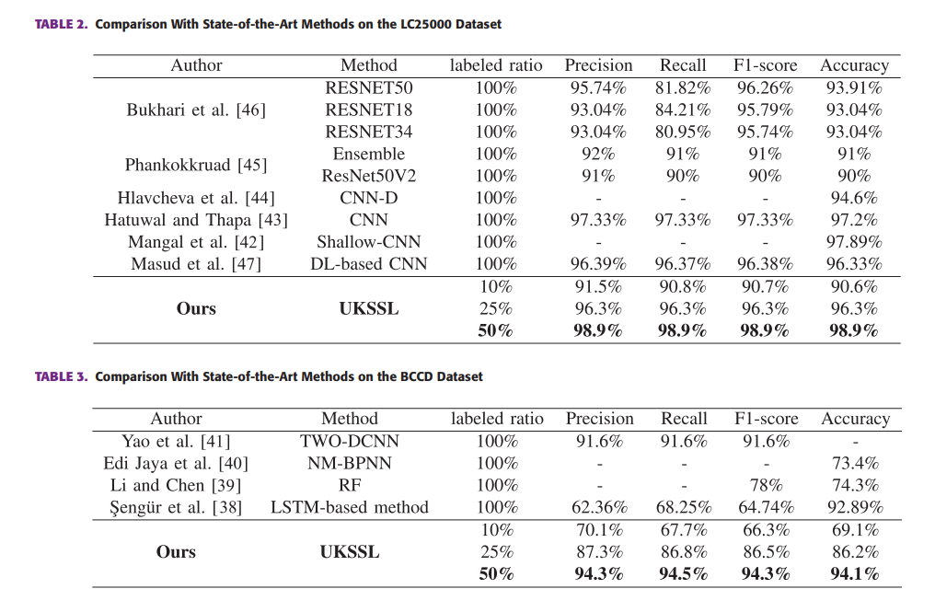

Slide 9
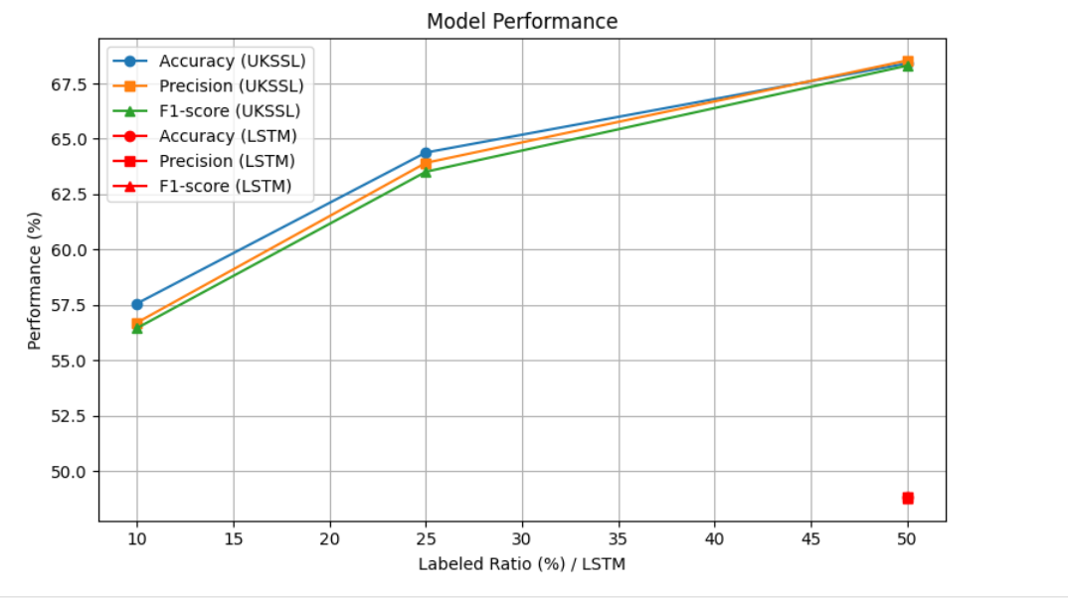
Visualization

Slide 10
References
1. X. Chen and K. He, “Exploring simple siamese representation learning,” in Proc. IEEE/CVF Conf. Comput. Vis. Pattern Recognit., 2021, pp. 15750–15758.
2. J. Grill et al., “Others bootstrap your own latent-a new approach to selfsupervised learning,” in Proc. Annu. Conf. Neural Inf. Process. Syst., 2020, pp. 21271–21284.
3. M. Caron, I. Misra, J. Mairal, P. Goyal, P. Bojanowski, and A. Joulin, “Unsupervised learning of visual features by contrasting cluster assignments,” in Proc. Annu. Conf. Neural Inf. Process. Syst., 2020, pp. 9912– 9924.

Slide 11
THANK YOU

